Slide 1
Windows 10 IoT and Raspberry Pi
By Lee Perkins

Slide 2
About Me
Lee Perkins
leep@tigerbase.com
Programming since 1981
Sr. Software Engineer @ IssueTrak
Frequently found here at HRNUG

Slide 3
Internet of Things
“The [IoT] … is the network of physical objects or ‘things’ embedded with electronics, software, sensors, and connectivity to enable objects to exchange data with … other connected devices”
“The Internet of Things allows objects to be sensed and controlled remotely across existing network infrastructure, creating opportunities for more direct integration between the physical world and computer-based systems”
-- Wikipedia
-- https://en.wikipedia.org/wiki/Internet_of_Things

Slide 4

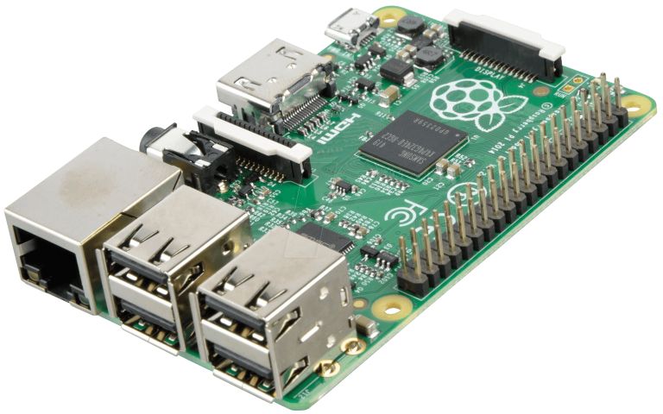
Raspberry Pi

Slide 5
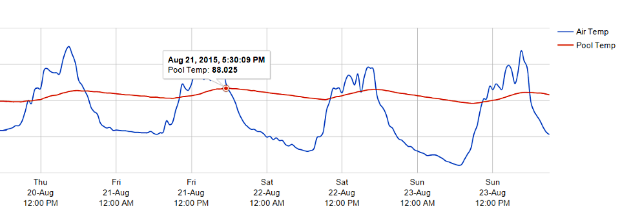
Pool Pi

Slide 6
Raspberry Pi
Intended to Promote Teaching Programming
900MHz Quad-Core ARMv7 Processor
1GB Ram, 4 USB, HDMI, Ethernet, Micro SD
Combined Audio/Composite video jack
40 General Purpose I/O (GPIO) Pins

Slide 7

Windows 10 IoT Core
Raspberry Pi 2 and MinnowBoard Max
Headless (no screen) or headed (with UI)
GUI limited to XAML, HTML and DirectX
UWP Languages: Visual C++, C#, VB.NET, JavaScript, plus Node.js and Python

Slide 8
‘Nuff with the slides!
Windows 10 IoT
on the
Raspberry Pi

Slide 9
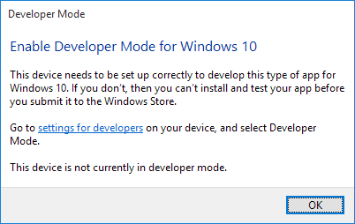

Slide 10
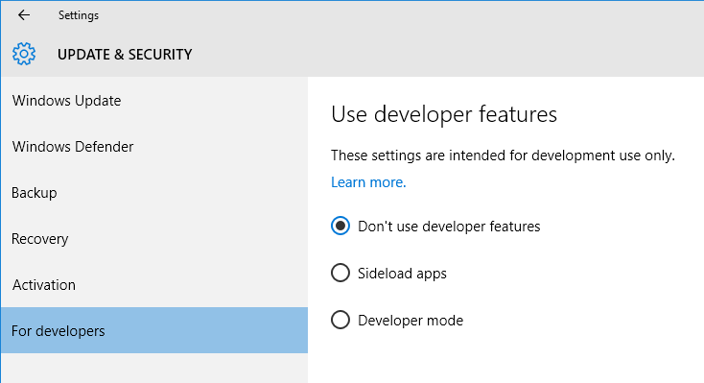

Slide 11
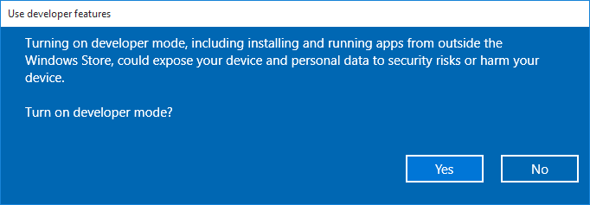

Slide 12
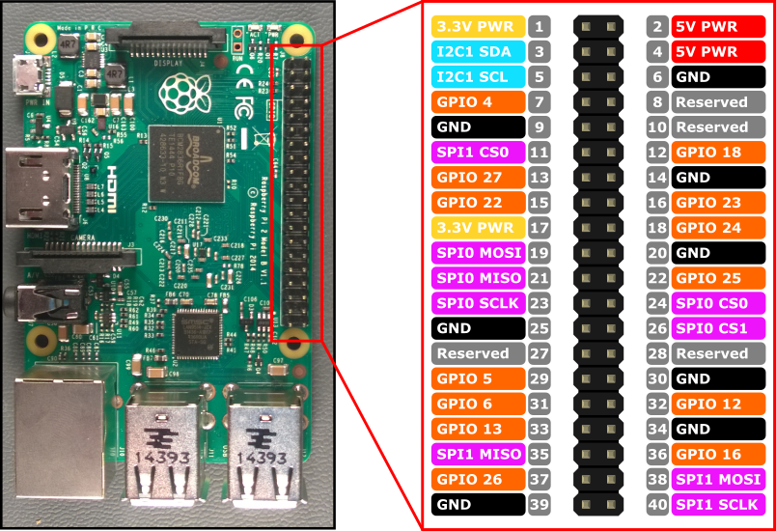

Slide 13
